Slide 1
Sales User Training

Slide 2
B2B Marketing Automation
What is Pardot?

Slide 3
Introduction to Pardot
Leader in B2B Sales & Marketing Automation
Based in Atlanta, GA
Helping shorten sales cycles since 2007
Acquired by Salesforce in July 2013
Notes:
Pardot’s marketing automation software helps you maximize your company’s marketing efforts with minimal time and resources.
Marketing Automation
Getting your marketing message to resonate with your target consumer in today’s increasingly crowded marketplace is one of the greatest challenges facing marketers today. The internet and related technologies have revolutionized the face of today’s marketing arena, creating consumers that are more empowered and markedly more sophisticated than their predecessors.
Traditional marketing campaigns have lost their efficacy as more sophisticated marketing automation campaigns have taken over.
What is Marketing Automation?
Simply put, marketing automation works to automate your marketing communication programs.
With a marketing automation platform in place, your marketing and sales teams will be able to automate and optimize your lead generation and nurturing programs from the very first contact you have with a prospect through the entire sales process.
How Does Marketing Automation Work?
Marketing automation integrates email marketing, reporting technology, and your lead generation and nurturing efforts to create a true sales ecosystem. It allows you to create timely, structured communication programs with all of your prospects, with minimal time and resources.
How Can Marketing Automation Help You?
Marketing automation helps your company save time and resources by automating many of your lead nurturing programs effectively and efficiently.
You can set up convenient drip marketing campaigns that automate your email campaigns, social media activities, and streamline your reporting, all of which allow you to concentrate on the bigger picture – growing your business.

Slide 4
How Pardot Will Help You
Better qualify leads
Increase targeted sales
Save time
Close deals faster

Slide 5
70%
of your mishandled
leads will buy
from a competitor
within 24 months

Slide 6
Salesforce Integration, Prospect Activity, Lead Qualification, Nurturing Programs, etc.
Important Features

Slide 7
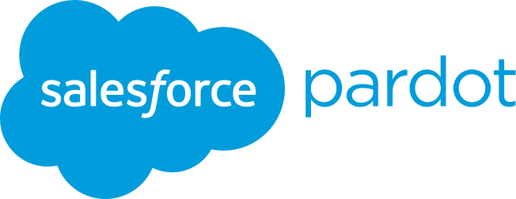
Salesforce
Integration with Pardot
View Pardot info from within your Salesforce account
You do not have to login Pardot to view information prospect info
Valuable information from Pardot improves Salesforce usage
Notes:
Pardot is a NetSuite Suite Flex partner and integrates natively with the on-demand CRM and ERP platform.
You will be able to see all prospect activity within NetSuite and quickly assign leads to sales reps.
Integrate Pardot with NetSuite to get a complete solution that covers all parts of the funnel.
• See all prospect activity from within NetSuite • Deduplicate new records • Bidirectionally sync data between the two systems
For more information: http://www.pardot.com/help/faqs/category/crm/netsuite-crm

Slide 8
Salesforce
Pardot Fields

Slide 9
Salesforce
Prospect Activities
Score
Point associated with activity
Date/Time
When the activity occurred
Type
Specific activity
Campaign
Pardot campaign associated with activity
Activity
Email, form, landing page, browsing activity and much more!
Notes:
Prospects’ activities (tracked in Pardot) are shown within lead and contact records in NetSuite.
For more information: http://www.pardot.com/help/faqs/category/crm/netsuite-crm

Slide 10
Salesforce
Prospect Score
Lead Scoring
A score is generated based on the prospect’s activity level. The score tells you the prospect’s interest in your company through their level of engagement.

Slide 11
Salesforce
Prospect Grade
Lead Grading
Grading is based on your company's unique criteria for an ideal prospect (job title, company size, etc). Grading defines the ideal prospect and tells you how interested you should be in that prospect.

Slide 12
Salesforce
Scoring and Grading
Pardot Grade
How well does this prospect match the ideal profile?
Pardot Score
Has this prospect taken important activities online?

Slide 13
Salesforce
Social Data

Slide 14
Salesforce
Prospect Lists

Slide 15
Salesforce
Prospect Activity History
Emails
Type of emails:
List emails, plug-in emails, drip program emails
Subject line indicates what kind of email was sent to your prospect

Slide 16
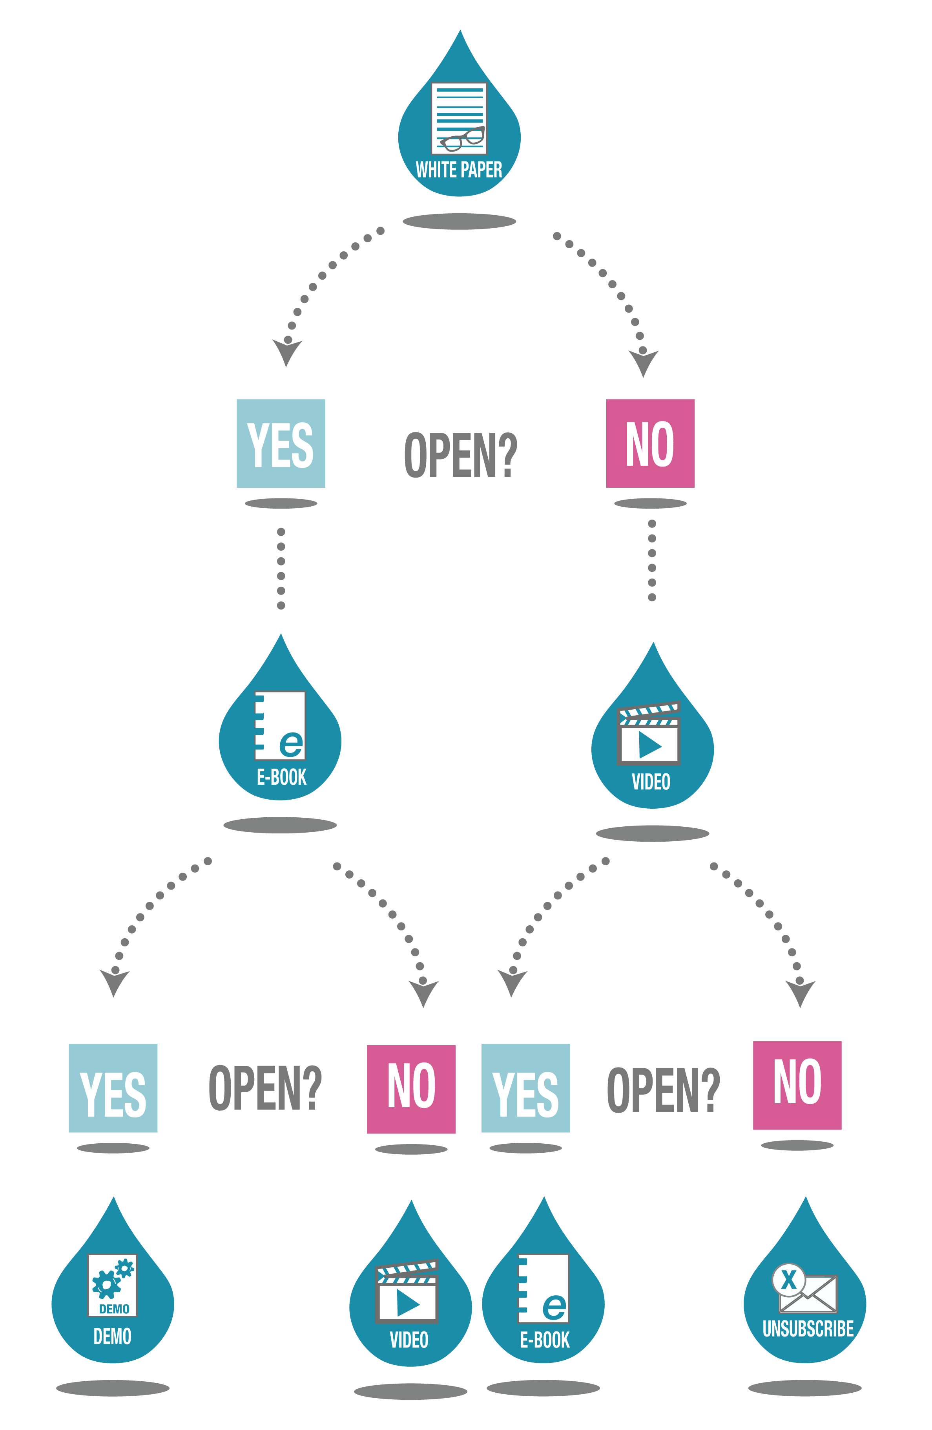
Nurturing Campaigns
This example illustrates one way in which drip campaigns can be used to nurture prospects.

Slide 17
Email Plug-Ins, LeadDeck
Tools for Sales

Slide 18
Salesforce1

Slide 19
Email Notifications, Daily Reports, User Settings
User Settings

Slide 20
User Settings
Selecting email alerts and daily reports
HTML/text signatures
Adding more user info

Slide 21
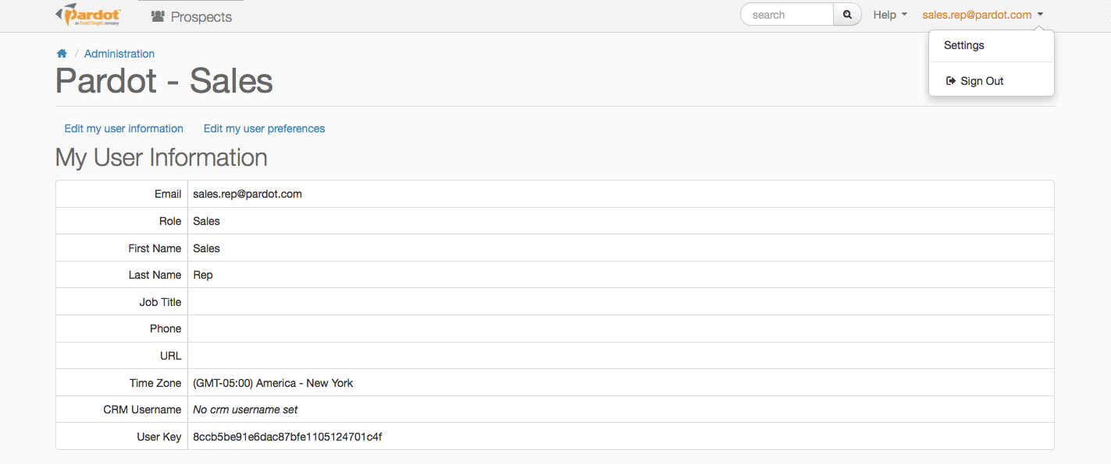
Setting Email Notifications

Slide 22
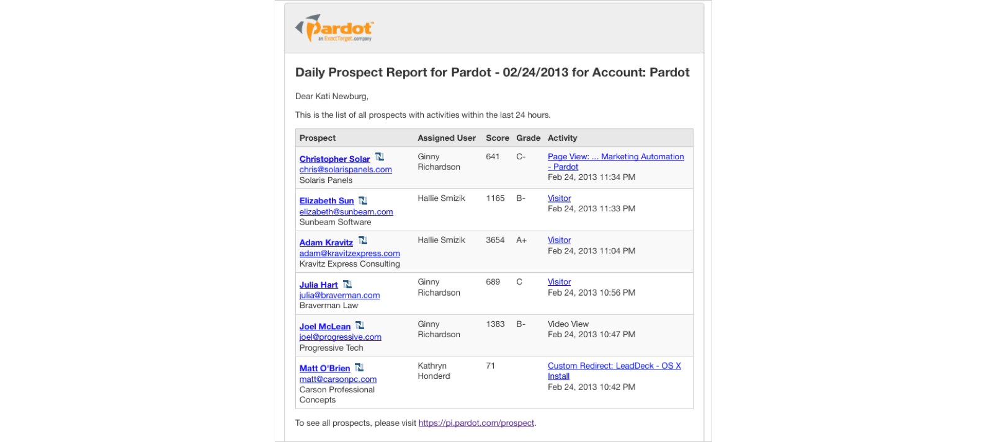
Email Notifications
Daily Activity Report: All Prospects

Slide 23
Email Notifications
Daily Activity Report: Assigned
Prospects

Slide 24
Email Notifications
Prospect Assignment

Slide 25
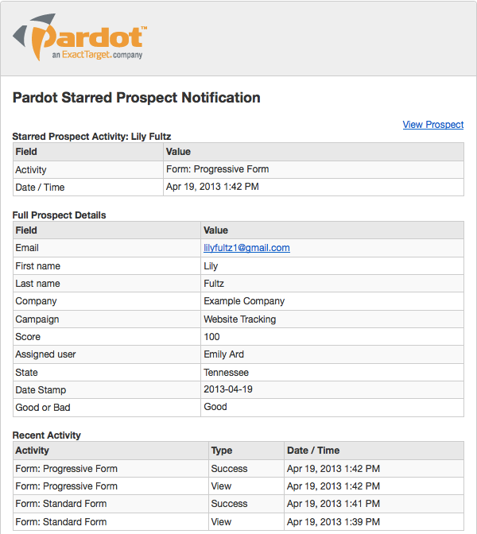
Email Notifications
Starred Prospect Activity Alerts

